Slide 1




Centering Prayer Introductory Workshop
Contemplative Outreach
Notes:
1. Centering Prayer Introductory Workshop
Centering Prayer Introductory Workshop
NOTES TO PRESENTER:
In this first conference, it is important to know your audience and tailor the content to the group. Feel free to adjust and be flexible.
You may read aloud all the quotes from Thomas Keating’s Open Mind, Open Heart (2006) in all conferences. Depending on the audience, context, and time restraints, the reading(s) may be skipped.
Your **Options** are indicated by **four asterisks**.
Welcome
This “Welcome” can be given by the host or a presenter.
Opening Prayer: Use the prayer provided or use your own opening prayer.
**Option**
“Divine Indwelling Presence,
Bless this time together and make it a sacred time as we wait upon you. Bless each of us
as we come answering your call to seek a deeper relationship with you, and bless us
together with the unity of your Holy Spirit. Amen”
Introductions: introduce presenter(s) and welcome participants.
Introduction of the participants can be devised to fit the situation.
Go over the Schedule
In this workshop, we will learn what Centering Prayer is, how to do it, why you may want to do it, and experience Centering Prayer together.
Review the Workshop schedule including an ending time.
Review practical details such as the location of bathrooms, coffee/water table, book tables, etc.
PRESENTERS NOTES:
The following slides are duplicated 9&10, 11&12, 21&22, 40&41 because the notes were long. Only the presenter sees the notes when “use presenter view” is checked or when “notes page” is printed as speakers notes. The audience should not notice the two slides since they are identical.
Open with a prayer
You may use either the prayers provided in the Presenter Formation Handbook for Centering Prayer or use your own opening prayer
Welcome and reverence each participant
Introduction of presenters
Introduction of participants to each other and the group if it is a small group. If it is a large group, introductions can be devised to fit the situation.
Share an Explanation of Contemplative Outreach
Contemplative Outreach was founded in 1984 under the leadership of Fr. Thomas Keating. Our purpose is to renew the contemplative dimension of the Gospel in everyday life. Our vision is to share the method of Centering Prayer and its immediate conceptual background.
Contemplative Outreach is a worldwide community made up of individuals and small faith prayer groups committed to the practice of Centering Prayer. Over the years, we have assisted groups in establishing local Chapters around the world.

Slide 2

Prayer as Relationship
Conference One
Notes:
2. Prayer as Relationship
Conference One
NOTES TO PRESENTER:
CONFERENCE TITLE SLIDE | No suggested content

Slide 3
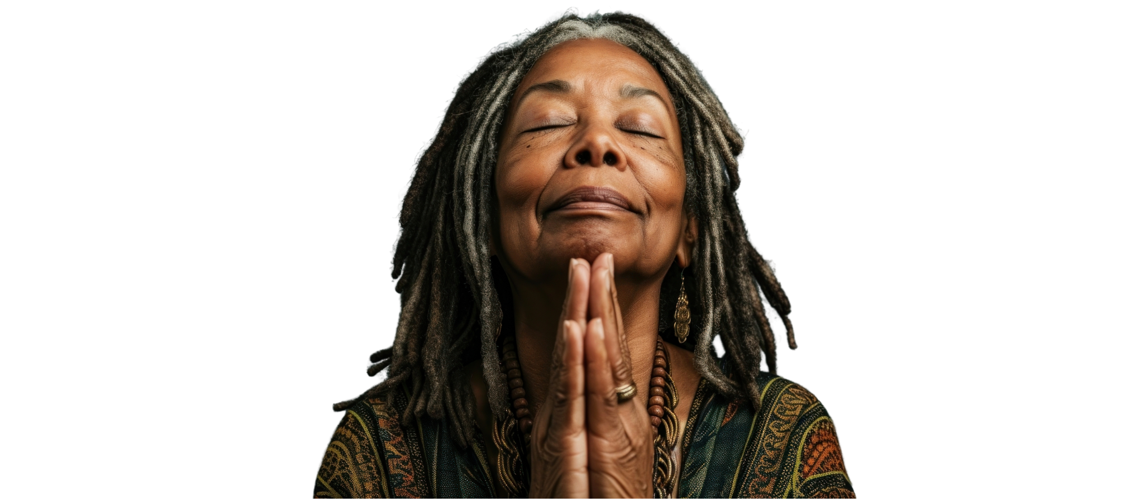



What is Prayer?
Notes:
3. What is Prayer?
Ask participants: “What is prayer to you?”
**Options**
If it is a small group, have the participants share “what prayer is” to them.
If it is a large group, have them get in small groups and share in their groups.

Slide 4
What is prayer?
Prayer is a relationship
Notes:
4. What is Prayer?
Prayer is a relationship. When we pray, we are opening to a deeper relationship with God.
We may think of prayer as thoughts or feelings expressed in words. But this is only one expression of prayer.
Fr. Thomas Keating, a founder of the Centering Prayer movement, said, “We know by faith God is within us, closer than breathing, closer than thinking, closer than our consciousness itself. God is the ground of our being. God is the Source from whom our life comes at every moment.”
So grounded in this way, when we pray, we are opening to a deeper relationship with God.

Slide 5
Centering Prayer
Notes:
5. What is Centering Prayer?
Centering prayer is a simple method of silent prayer to deepen our relationship with God. It is a movement beyond conversation into communion with God, beyond words, thoughts, and feelings.

Slide 6
Centering Prayer and the
Wisdom Saying of Jesus
    “…when you pray, go to your inner room,
    close the door, and pray...”
    - Matthew 6:6
Notes:
6. Centering Prayer and the Wisdom Saying of Jesus
Centering Prayer is based on Jesus’s saying in Matthew 6:6 (NAB).
Jesus said, “When you pray, go to your inner room, close the door, and pray to your Father in secret. And your Father who sees in secret will reward you.”
The inner room Jesus speaks of is within us. We already have this inner room, and it is always available to us. Therefore, Centering Prayer is accessible to everyone.
The source of Centering Prayer is the “Indwelling Trinity”—Father, Son, and Holy Spirit (John 14:20). God is not only infinitely outside of us but also intimately within us.
Centering Prayer is also inspired by Christian contemplative tradition.

Slide 7

Why practice
Centering Prayer?
Notes:
7. Why practice Centering Prayer?
Centering Prayer practice can deepen our relationship with God.
Fr. Keating writes in Open Mind, Open Heart (2006), “The present moment, every object we see, our inmost nature are all rooted in God. But we hesitate to believe this until personal experience gives us the confidence to believe in it. This involves the gradual development of intimacy with God.”
Centering Prayer is a discipline of consistent practice to nurture and deepen our relationship with God.
Centering Prayer does not replace other kinds of prayer. Rather, it deepens other prayers.

Slide 8
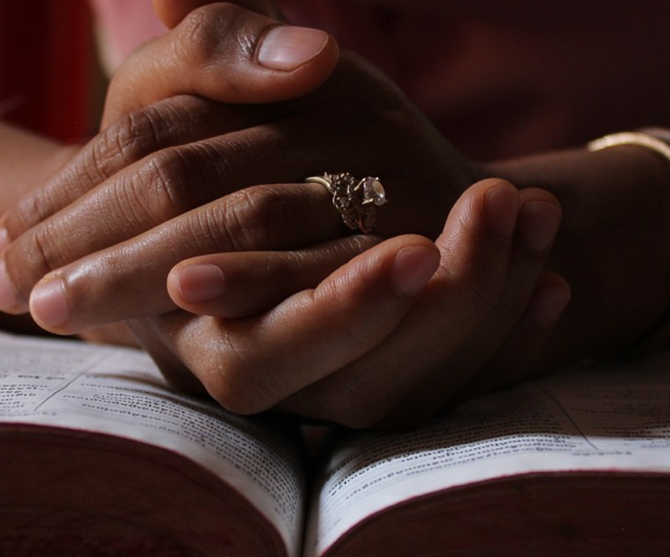
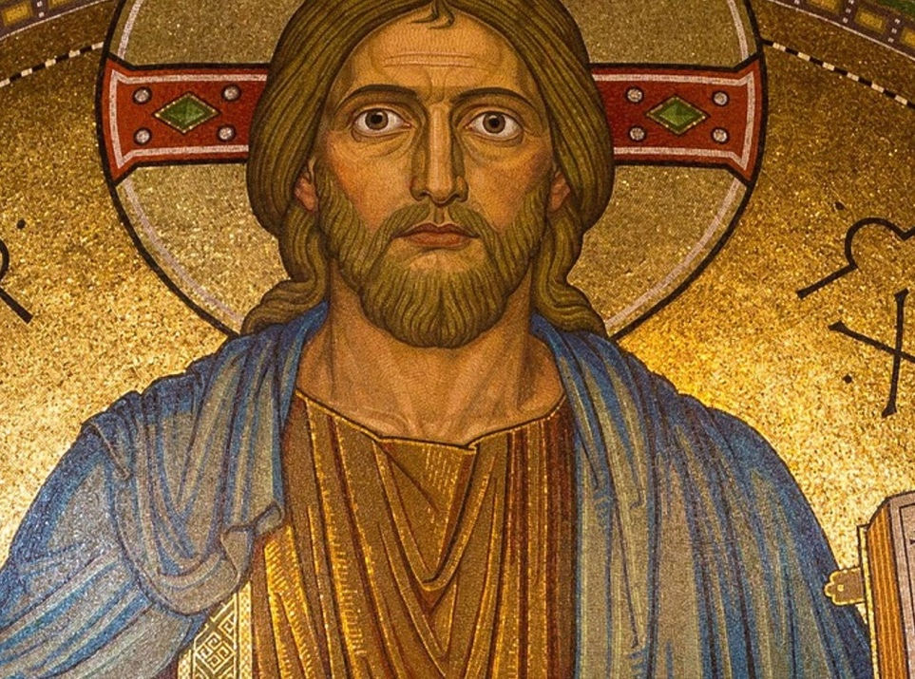
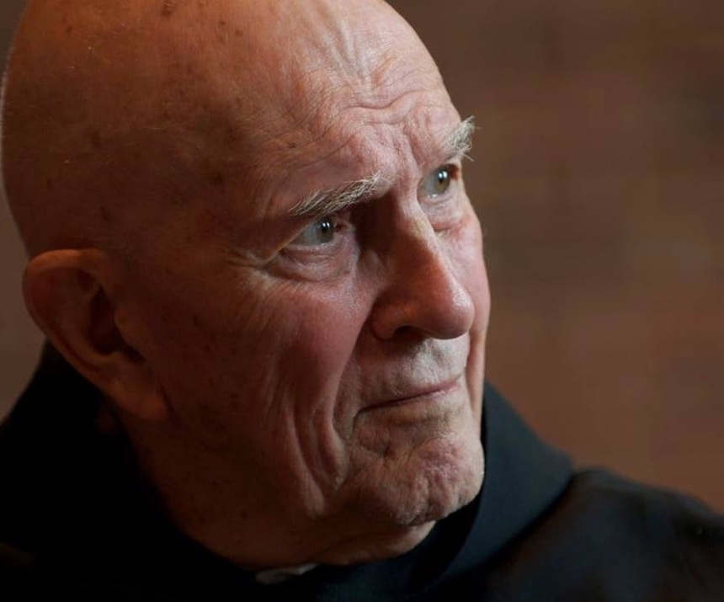
Option
Scripture
Tradition
Community
Notes:
8. Option
**Option**
There are many methods of contemplative prayer. In this workshop, we will focus on Centering Prayer. Centering prayer prepares us to receive the gift of contemplation from God. It is an opening of mind and heart—our whole being—to God, the Ultimate Mystery, beyond thoughts, words, and emotions. It is simply resting in the presence of God.
Slide 9 (Option: Contemplative Dimension within Scripture)
Slide 10 (Option: The Christian Contemplative Tradition)
Slide 11 (Option: History of Contemplative Outreach)

Slide 9
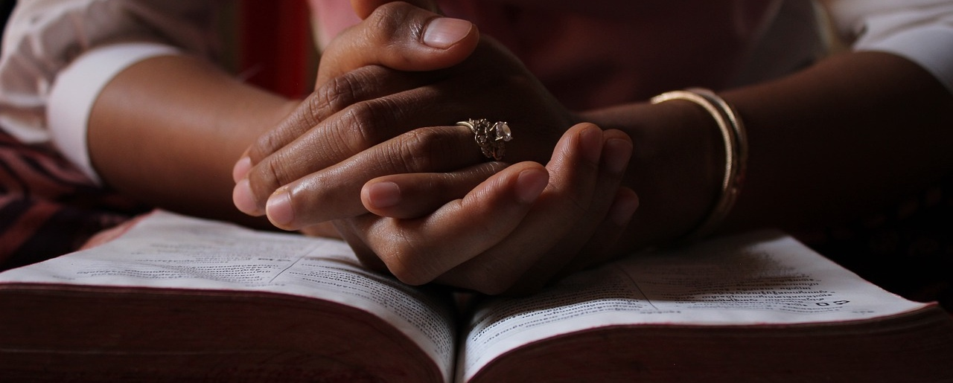
Contemplative Dimension within Scripture
Notes:
**Option** 9. Contemplative Dimension within Scripture
Jesus said, “When you pray, go to your inner room, close the door, and pray to your Father in secret. And your Father who sees in secret will reward you.” - Matthew 6:6 (NAB)
On that day you will know that I am in my Father, and you in me, and I in you. - John 14:20 (NRSV)
Jesus said, “Come to me, all of you who are weary and carry heavy burdens, and I will give you rest. Take my yoke upon you. Let me teach you, because I am humble and gentle at heart, and you will find rest for your souls. - Matthew 11:28-29 (NRSV)
I pray that you may have the power to comprehend, with all the saints, what is the breadth and length and height and depth, and to know the love of Christ that surpasses knowledge, so that you may be filled with all the fullness of God. - Ephesians 3:18-19 (NRSV)
We love [God] because [God] first loved us. - I John 4:19 (NRSV)
Be still and know that I am God. - Psalm 46:10 (NRSV)

Slide 10
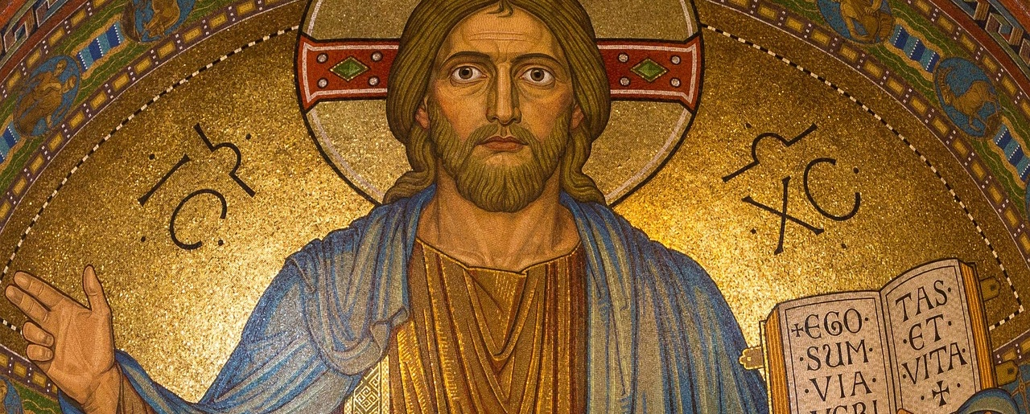
The Christian Contemplative Tradition
Notes:
**Option** 10. The Christian Contemplative Tradition
Adapted from the Contemplative Outreach website.
https://www.contemplativeoutreach.org/the-christian-contemplative-tradition
For the first 16 centuries of the Christian era, contemplation had a specific meaning. St. Gregory the Great summed it up at the end of the 6th century as the knowledge of God that is impregnated with love. He referred to contemplation as “resting in God.”
In this “resting,” the mind and heart are not so much seeking God as beginning to experience what they have been seeking in a single act or thought, and then sustaining their consent to God’s presence and action.
In this tradition, contemplation, or contemplative prayer, is not something that can be achieved through will but is rather God’s gift. It is the opening of mind and heart–one’s whole being–to God. Contemplative prayer is a process of interior transformation. It is a relationship initiated by God and leading, if one consents, to divine union.
Contemplative Christian prayer has been practiced in every age beginning with the Desert Fathers and Mothers.
In the Middle Ages, this contemplative heritage continued with St. Bernard of Clairvaux, Meister Eckhart, the unknown author of The Cloud of Unknowing, and Julian of Norwich, among others.
After the Reformation, St. Teresa of Avila, St. John of the Cross, and St. Therese of Lisieux all cultivated practices which they believed led to the spiritual gift of contemplation.
In more modern times, initiatives to renew contemplative prayer were led by Thomas Merton, Thomas Keating, and John Main. Prayer of Faith, Prayer of the Heart, Pure Prayer, Prayer of Simplicity, Prayer of Simple Regard, Active Recollection, Active Quiet, and Acquired Contemplation are modern practices.
These prayers, based on historical practices, were meant to prepare practitioners for contemplation. Contemplative Outreach promotes Centering Prayer and Lectio Divina, derived from ancient contemplative Christian practices in updated formats.

Slide 11
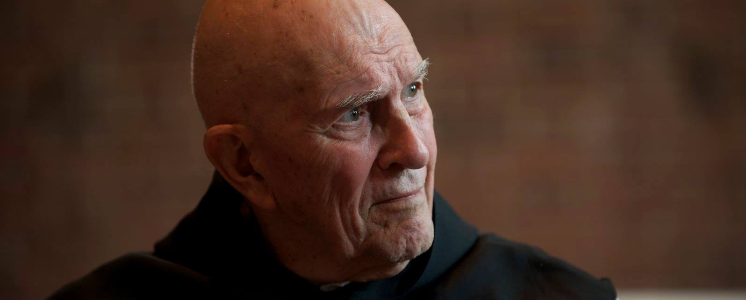

History of Contemplative Outreach
Notes:
**Option** 11. History of Contemplative Outreach
Adapted from Open Mind Open Heart, page 182.
In the mid 1970’s, as a response to people’s deep hunger for the contemplative tradition in Christianity, a group of Trappist monks at St. Joseph’s Abbey in Massachusetts introduced a practice called Centering Prayer. The method was first developed by Fr. William Menninger, based on the 14th Century classic The Cloud of Unknowing. The response was very positive. Workshops outside the monastery were given by Fr. Basil Pennington.
In 1981, Fr. Thomas Keating resigned as abbot of St. Joseph’s and moved to St. Benedict’s Monastery in Colorado. Requests for more intensive Centering Prayer experiences began to surface. Father Keating held many Centering Prayer workshops worldwide as well as Intensive Centering Prayer Retreats.
In 1984, Contemplative Outreach, Ltd. was established to coordinate efforts to introduce the Centering Prayer method to persons seeking a deeper life of prayer and to provide a support system capable of sustaining their commitment.
Contemplative Outreach is a worldwide community made up of individuals and prayer groups committed to the practice of Centering Prayer. Our purpose is to renew the contemplative dimension of the Gospel in everyday life.

Slide 12
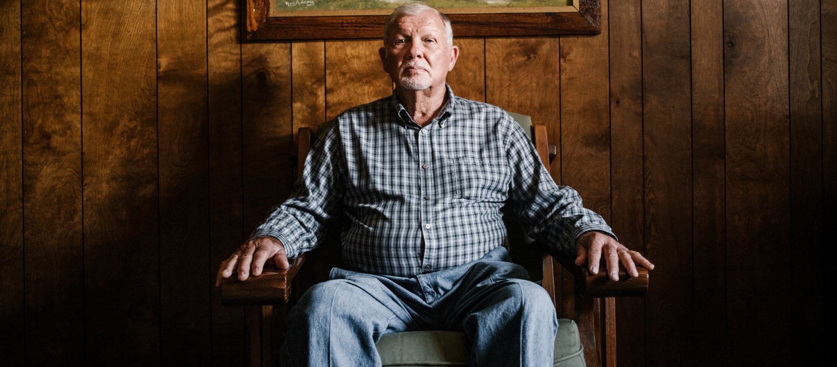
The Method of Centering Prayer
The Prayer of Consent
Conference Two
Notes:
12. The Method of Centering Prayer
The Prayer of Consent
Conference Two
NOTE TO PRESENTER:
CONFERENCE TITLE SLIDE | No suggested content

Slide 13
Centering Prayer is
both
a relationship with God
and
  a method and discipline
  to deepen this relationship.
Notes:
13. Centering Prayer is both
a relationship with God and
a method and discipline to deepen this relationship.
We commit to Centering Prayer out of love of, and desire to grow closer to, God.

Slide 14
The Guidelines
1. Choose a sacred word as the symbol of your intention to consent to God’s presence and action within.
2. Sitting comfortably and with eyes closed, settle briefly and silently introduce the sacred word as the symbol of your consent to God’s presence and action within.
3. When engaged with your thoughts, return ever-so-gently to the sacred word.
4. At the end of the prayer period, remain in silence with eyes closed for a couple of minutes.
Notes:
14. The Guidelines
NOTES TO PRESENTER: Read the guidelines through completely before explaining them.
Choose a sacred word as the symbol of your intention to consent to God’s presence and action within.
Sitting comfortably and with eyes closed, settle briefly and silently introduce the sacred word as the symbol of your consent to God’s presence and action within.
When engaged with your thoughts, return ever-so-gently to the sacred word.
At the end of the prayer period, remain in silence with eyes closed for a couple of minutes.

Slide 15
Guideline 1
“Choose a sacred word as the symbol of your intention to consent to God’s presence and action within.”
Notes:
15. Guideline 1
Choose a sacred word as the symbol of your intention to consent to God’s presence and action within.
The sacred word is sacred not because of its inherent meaning but because of the meaning we give it as the expression of our intention to consent.
Consent is the heart and soul of Centering Prayer. For this reason, Centering Prayer may also be called the “Prayer of Consent.”
The sacred word is a way of renewing our intention to be open to God and accept God as God is.
NOTES TO PRESENTER: You may use this or your own example to illustrate intention to consent.
**Option** A traditional example in our culture of the power of intention to consent is the engagement before marriage, while the power of consent is the “I do” in the marriage ceremony. Like the wedding ring, the sacred word is a symbol of our consent to the relationship.

Slide 16
Sacred Word
A few examples:
Jesus
Mercy
Abba
Silence
Peace
Yes
Notes:
16. Sacred Word
The sacred word is chosen during a brief prayer to the Holy Spirit. There isn’t a right word, a wrong word, a better word, or a more sacred word. The sacred word is a symbol that expresses your intention to consent. Any one or two syllable word will do as long as it does not put your mind into a thinking mode.
Examples: God, Jesus, Mercy, Yes, Love, Listen, Peace, Let Go, Silence, Trust, Here, Now. You may choose a word from another language, such as Abba or Shalom.
Having chosen a sacred word, do not change it during the period of Centering Prayer because that would be engaging in thoughts.
Before our first Centering Prayer period, we will guide you in choosing a sacred word.

Slide 17
Guideline 2
“Sitting comfortably and with eyes closed, settle briefly and silently introduce the sacred word as the symbol of your consent to God’s presence and action within.”
Notes:
17. Guideline 2
Sitting comfortably and with eyes closed, settle briefly and silently introduce the sacred word as the symbol of your consent to God’s presence and action within.
NOTES TO PRESENTER: Demonstrate the sitting position.
“Sitting comfortably” means relatively comfortable so as not to encourage sleep during the time of prayer. If we fall asleep, we simply continue the prayer upon awakening.
Our interior disposition in this prayer is alert receptivity.
Whatever sitting position we choose, we keep the back straight.
“Settle briefly” with a couple of deep breaths or stretches, a spoken prayer of intention, or a short reading.
We close our eyes as a symbol of letting go of what is going on around and within us.
We introduce the sacred word inwardly as gently as laying a feather on a piece of absorbent cotton.

Slide 18
Guideline 3
“When engaged with your thoughts, return ever-so-gently to the sacred word.”
Notes:
18. Guideline 3
When engaged with your thoughts, return ever-so-gently to the sacred word.
“Thoughts” is an umbrella term for every perception including body sensations, sense perceptions, feelings, images, memories, plans, reflections, concepts, commentaries, and spiritual experiences.
Thoughts are an inevitable, integral, and normal part of Centering Prayer.
By “returning ever-so-gently to the sacred word,” we give a minimum effort. This is the only activity we initiate during the time of Centering Prayer.
During the time of Centering Prayer, the sacred word may become vague or disappear.

Slide 19
Guideline 4
“At the end of the prayer period, remain in silence with eyes closed for a couple of minutes.”
Notes:
19. Guideline 4
At the end of the prayer period, remain in silence with eyes closed for a couple of minutes.
The additional time enables us to gently bring the atmosphere of silence into the activity of everyday life.
If this prayer is done in a group, the leader may slowly recite a prayer such as the Lord’s Prayer while the others listen.
The recommended time for this prayer is twenty minutes.
**Option** Read aloud from Open Mind, Open Heart (2006), p. 32.
On the Spiritual Level of Being
“The sacred word is a way of renewing your intention to open yourself to God and to accept God as God is. While this does not prevent anyone from praying in other forms at other times, the period of Centering Prayer is not the time to pray specifically for others. By consenting to God, you are implicitly praying for everyone past, present, and future. You are embracing the whole of creation. You are accepting all reality, beginning with God and with that part of your own reality of which you may not be generally aware, namely, the spiritual level of your being.”

Slide 20

Notes:
20. Transition to Centering Prayer
Choosing A Sacred Word of One or Two Syllables
NOTES TO PRESENTER:
Invite participants to close their eyes.
Begin with a short prayer to the Holy Spirit. For example: “Loving Spirit of God, we open our hearts to you as we choose our Sacred Word.”
There isn’t a better word or more sacred word.
After choosing a sacred word, do not change it during the period of Centering Prayer because that would be engaging thoughts.
Examples: God, Jesus, Mercy, Yes, Love, Listen, Peace, Let Go, Silence, Trust, Here, Now. You may choose a word from another language, such as Abba or Shalom.
Give the participants time to choose a sacred word, a word of one or two syllables (approximately two minutes).
If they are unable to choose a word at this time, suggest using the word “peace” or “yes.”

Slide 21

Notes:
21. First Period of Centering Prayer
NOTES TO PRESENTER: Lead the participants into their first period of Centering Prayer. Guide them into a comfortable yet alert sitting position that suits each of their physical conditions well.
I invite you to close your eyes.
Your sacred word is a symbol of your consent to God’s presence and action within.
Effortlessly and ever-so-gently return to your sacred word when you notice you have been engaged in thoughts, feelings, and sensations.
When the prayer period ends, as indicated by the bell (or a prayer), I will recite a prayer slowly while you listen and remain in silence with eyes closed for a couple of minutes.
NOTES TO PRESENTER:
As you begin the prayer, invite participants to silently introduce their sacred word as the symbol of their consent to God’s presence and action within.
Begin ten to twenty (10-20) minutes of Centering Prayer after a couple of deep breaths, a spoken prayer of intention, or a short scripture reading.
At the end of the period of Centering Prayer, the presenter recites a prayer slowly (such as the Lord’s Prayer) while participants listen.
After a pause, invite participants to gently open their eyes.
Ask: “Are there any questions about Centering Prayer now that you have had a chance to experience the prayer?” (After the second period of Centering Prayer they will be invited to share their experience in these two Centering Prayer periods.)

Slide 22

Thoughts & the use of the Sacred Word
Conference Three
Notes:
22. Thoughts & Use of the Sacred Word
Conference Three
NOTE TO PRESENTER:
Conference Three TITLE SLIDE | No suggested content

Slide 23

Guideline 3
“When engaged with your thoughts, return
ever-so-gently
to the sacred word.”
Return ever-so-gently
Notes:
23. Guideline 3
“When engaged with your thoughts, return ever-so-gently to the sacred word.”
The sacred word is a symbol that expresses our consent to God’s presence and action within.
It is sacred not because of its inherent meaning but because of the meaning we give it as the expression of our consent.
When we are caught up in our thoughts, we gently return our sacred word. If a thought just comes and goes naturally, we do not need our word. We can think of our thoughts as boats on a river and God’s indwelling presence as the river itself. During Centering Prayer, we let go of our thoughts—we let them go by like boats floating down a river—and by faith we rest in God’s indwelling presence.
Each return to our sacred word is a prayer and an act of love.
Instead of a sacred word, a simple inward glance toward the Divine Presence, or a noticing of one’s breath may be a preferable symbol for some people. These require no physical expression. Whichever symbol is used, each expresses our consent to God’s presence and action.

Slide 24

“Thoughts” is an Umbrella Term
  Body sensations
  Sense perceptions
  Feelings
  Images
  Memories
  Plans
  Reflections
  Concepts
  Commentaries
  Spiritual experiences
Notes:
24. Thoughts is an Umbrella Term
“Thoughts” is an umbrella term for any perception at all, including
body sensations,
sense perceptions,
feelings,
images,
memories,
plans,
reflections,
concepts,
commentaries, and
spiritual experiences.

Slide 25
Thoughts are
Inevitable
Integral
and
Normal.
Notes:
25. Thoughts are Normal
Thoughts are an inevitable, integral and normal part of Centering Prayer.
Don’t judge thoughts as good or bad as that would be another thought.
Some thoughts contain what needs to be healed, and the silence creates a space for the healing to take place.

Slide 26


The 4 Rs
  Resist no thought.
  Retain no thought.
  React emotionally to no thought.
  Return ever-so-gently to the sacred word.
Let them come . . .
. . . Let them go
Notes:
26. How to Respond to Thoughts: The 4 Rs
Resist no thought.
Allow the thought.
Soften or drop resistance to thoughts.
Retain no thought.
Loosen your grip on thoughts.
However pleasant, inspired, or meaningful, like boats on a river simply let them float by.
React emotionally to no thought.
Soften or drop emotional reactions to thoughts.
Let go of the positive or negative emotions that might arise.
Return ever-so-gently to the sacred word when engaged with your thoughts.
When you realize you are engaged with a thought, simply return to the sacred word without judgment or undue energy.

Slide 27
Centering Prayer is
  a Method
  not
  a “Technique”
Notes:
27. Centering Prayer is a Method not a “Technique”
The meaning of “technique” is to follow a particular procedure and expect a desired result.
Centering Prayer is not considered a technique because there is no immediate cause and effect relationship.
We are developing a relationship of faith and trust without a specific goal or expectation.
(For example: In Centering Prayer we are not seeking the goal of relaxation, but we may have moments of refreshment and calm.)

Slide 28
During Centering Prayer
    We avoid
    analyzing our experience
    or
    harboring expectations
Notes:
28. During this prayer we avoid analyzing our experience or harboring expectations.
We are NOT
Repeating the sacred word continuously.
Avoiding all thoughts.
Making the mind a blank.
Achieving a spiritual experience.
Generally, having expectations about what should happen during Centering Prayer is an attempt to control the relationship with God. During our time in Centering Prayer, we may have thoughts such as
“Am I doing this prayer right?” or
“I don’t feel God’s presence.” or
“My sacred word is not working.”

Slide 29

Deepening of Faith
Notes:
29. Deepening of Faith
The consent of our will opens us to God’s divine presence and action within.
We have no human faculty to perceive this mystery of God.
We, therefore, do not judge our periods of Centering Prayer by our psychological experiences.
Our experience in Centering Prayer is not dependent on the “felt presence” of God but is a deepening of faith in God’s abiding presence.
**Option** “Likewise, the Spirit helps us in our weakness; for we do not know how to pray as we ought, but that very Spirit intercedes with sighs too deep for words.” (Romans 8:26, NRSV)

Slide 30
In Summary
Notes:
30. In Summary
Consent to God’s presence and action is the heart and soul of the Centering Prayer practice.
When engaged with your thoughts, feelings, and sensations, return ever-so-gently to the sacred word. By “returning ever-so-gently to the sacred word” we give a minimum of effort. This is the only activity we initiate during the time of Centering Prayer.
Centering Prayer is about heartfulness; we let go of our thoughts and sink into our relationship with God.
Once you grasp the fact that thoughts are not only inevitable but an integral part of the process of healing and growth initiated by God, you will be able to take a friendlier attitude toward them.
Centering Prayer fosters an attitude of letting go.
Thoughts do not interrupt this prayer unless you deliberately engage them or get up and walk out.
As we establish the Centering Prayer practice, we let the thoughts come and let them go.
The principles are: resist no thought, retain no thought, react emotionally to no thought, and when engaged with your thoughts, return ever-so-gently to the sacred word.
**Option** You may choose to read aloud from Open Mind, Open Heart (2006), p. 33.
On the Sacred Word
“The sacred word is a way of letting go of all thoughts. This makes it possible for our spiritual faculties, which are attracted to interior silence, to move spontaneously in that direction. Such a movement does not require effort. It only requires the willingness to let go of our ordinary preoccupations.”

Slide 31
Notes:
31. Transition to Centering Prayer
Second Period of Centering Prayer
NOTES TO PRESENTER: Lead the participants into a period of twenty (20) minutes of Centering Prayer. Guide them into a comfortable yet alert sitting position that suits each of their physical conditions well.
I invite you to close your eyes.
Your sacred word is a symbol of your consent to God’s presence and action within. Suggest using the sacred word they’ve chosen earlier.
Guideline #3—“When engaged with your thoughts, return ever-so-gently to your sacred word.
When the prayer period ends, as indicated by the bell (or a prayer), I will recite a prayer slowly while you listen and remain in silence with eyes closed for a couple of minutes.
NOTES TO PRESENTER:
As you begin the prayer, invite participants to silently introduce their sacred word as the symbol of their consent to God’s presence and action within.
Begin twenty (20) minutes of Centering Prayer after a couple of deep breaths, a spoken prayer of intention, or a short scripture reading.
At the end of the period of Centering Prayer, the presenter recites a prayer slowly (such as the Lord’s Prayer) while participants listen.
After a pause, invite participants to gently open their eyes.
Invite participants to share their experiences of Centering Prayer. This question is distinct from the one asked in Conference Two after the first period of Centering Prayer, where participants were encouraged to ask questions specific to the method of Centering Prayer. Here they are asked to share their experiences.

Slide 32
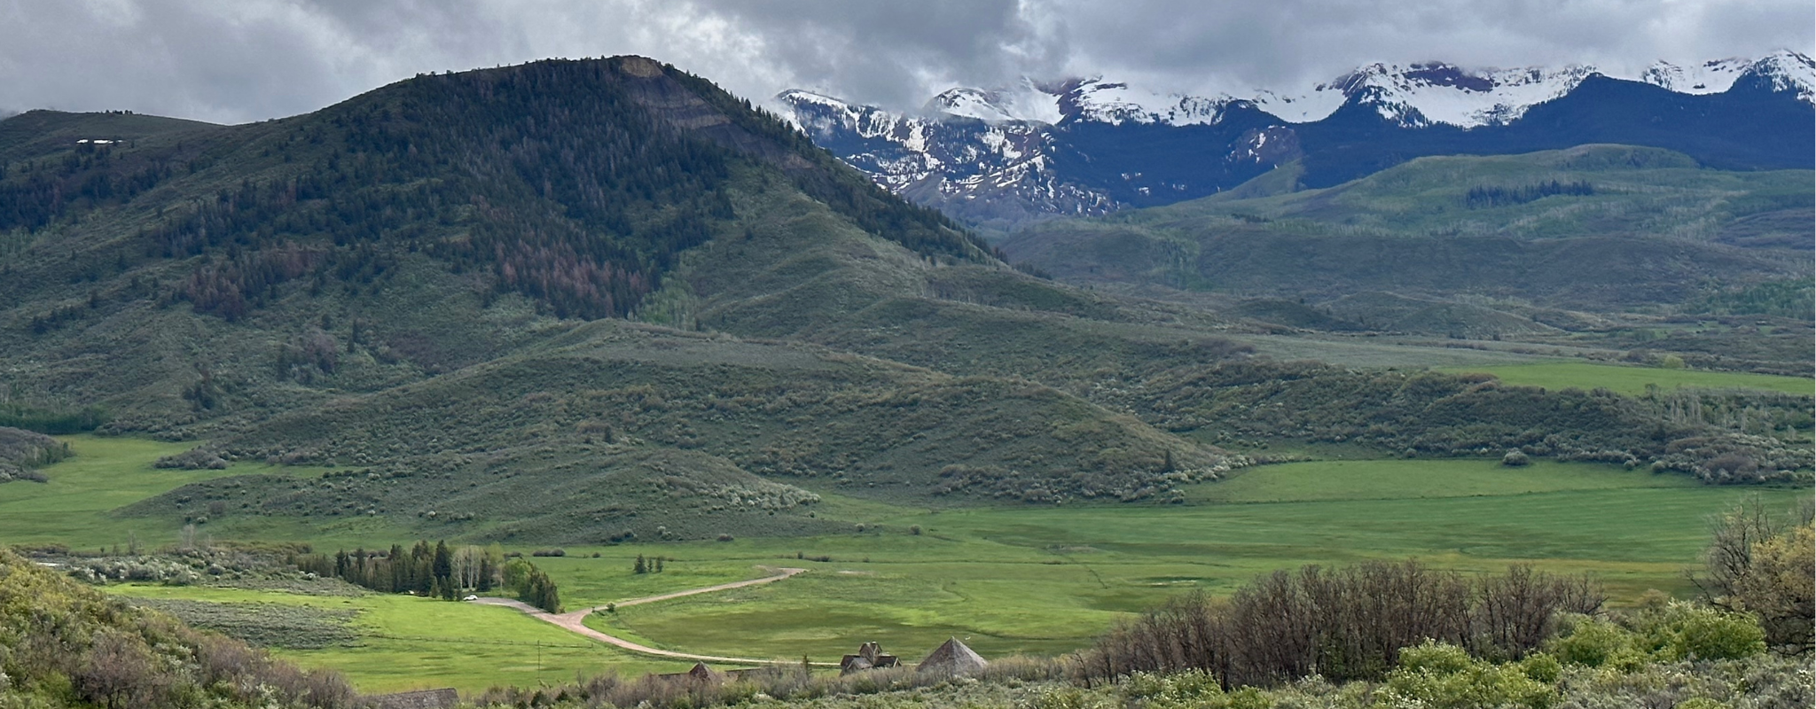
Deepening Our Relationship with God
Conference Four
Notes:
32. Deepening Our Relationship with God
Conference Four
We heard that prayer is a relationship with God, and Centering Prayer deepens our relationship with God.

Slide 33
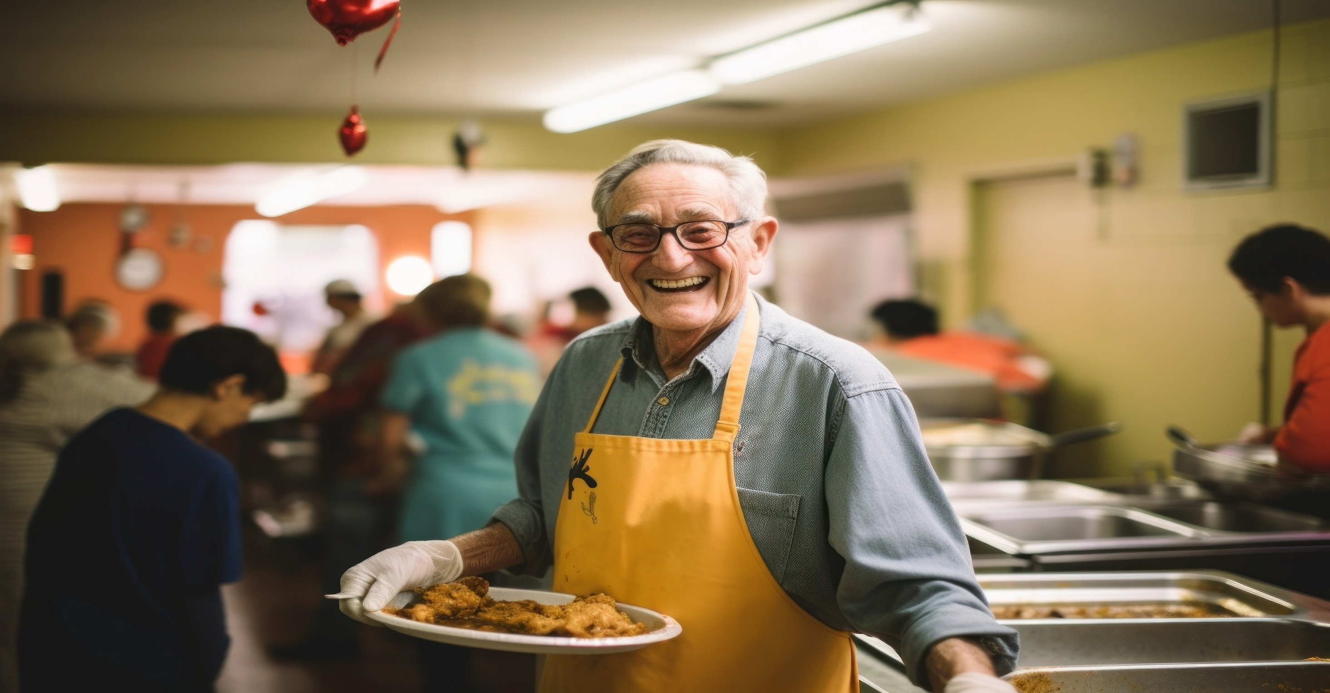

Gifts of Centering Prayer
Notes:
33. Gifts of Centering Prayer
Through faithful Centering Prayer practice, gifts may arise in us. The gifts of Centering Prayer appear more in daily life than in the time of Centering Prayer. Others may notice changes in us before we notice them, especially the Fruit of the Spirit: love, joy, peace, patience, kindness, generosity, faithfulness, gentleness, and self-control (Galatians 5:22, NRSV), as well as other gifts.
**Option** We may also begin to experience gifts of contemplative values: Silence, Solitude, Solidarity, and Service
Silence: A desire for more silence and a growing capacity to listen more deeply
Solitude: An enrichment in one’s prayer life and an increase in self-knowledge (may be painful)
Solidarity: An increasing awareness of oneness with God, with the whole human family, and with all of creation
Service: A non-judgmental attitude resulting in a practical caring for others and all of creation, as well as growing awareness of the social application of the gospel
These values foster the ability to live in the present moment.

Slide 34
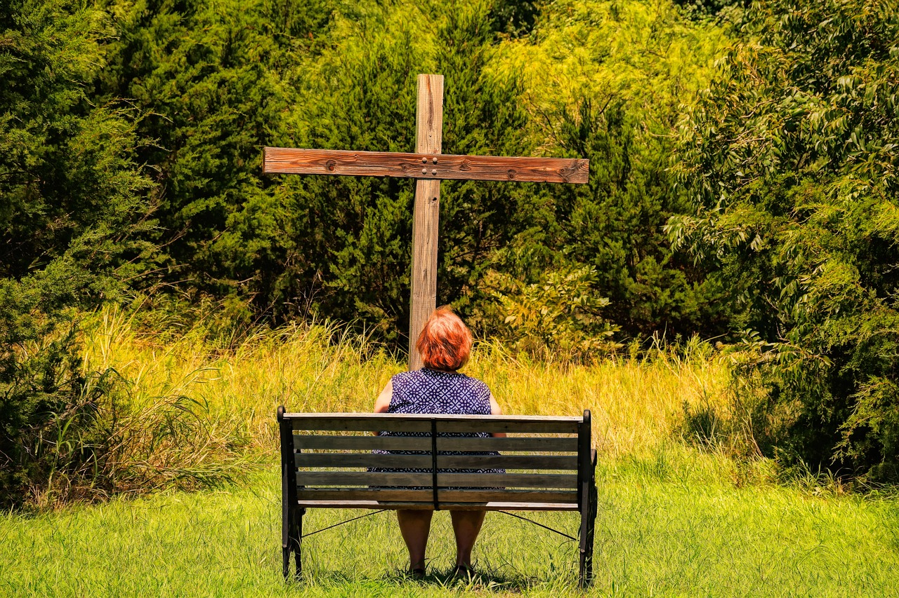
To Deepen our Relationship with God
  As you begin a daily practice of Centering Prayer
Notes:
34. To Deepen Our Relationship with God
When you think of your relationships that grew overtime, what helped them grow? Spending time is essential to deepen the relationship with others and with God.
When you begin a daily practice of Centering Prayer, it is recommended to pray for a period of 20 minutes twice daily. People new to Centering Prayer sometimes start with less time and build up to twenty minutes.
A period of 20 minutes is recommended because it takes time for our bodies to quiet down and to get beyond our usual preoccupations into interior silence.
Two periods of Centering Prayer a day help maintain a reservoir of interior silence.
Any new practice takes time and patience.

Slide 35


Helpful Ideas as you start your Centering Prayer practice
Centering Prayer Mobile App
Notes:
35.
NOTES TO PRESENTER: Share how you started your practice along with offering any helpful ideas such as those offered in Slides 35 - 38.
Using a Centering Prayer App

Slide 36

Helpful Ideas as you start your Centering Prayer practice
A reminder
in your
daily calendar
or phone
Notes:
36.
Setting a reminder in your daily calendar for a prayer time

Slide 37


Helpful Ideas as you start your Centering Prayer practice
Praying at the
same time and same place
Notes:
37.
Praying at the same time and same place

Slide 38

Helpful Ideas as you start your Centering Prayer practice
You might read
Thomas Keating’s
Open Mind, Open Heart
on your own
or in a group with others
Notes:
38.
Reading Open Mind, Open Heart by Thomas Keating

Slide 39


Join an ongoing
Centering Prayer Group
Notes:
39. Join an ongoing Centering Prayer group.
Prayer groups provide great support to persevere in your practice and opportunities to experience the spiritual journey with others, such as local prayer groups, Meditation Chapel prayer groups, and other online prayer groups.
Another way to receive support is to find a Centering Prayer practitioner to be a “soul friend.” (A soul friend is a trusted person with whom you can share your questions.)
**Option** Read aloud from Open Mind, Open Heart (2006), pp. 101-102.
On the Abiding Awareness of God
“The purpose of Centering Prayer is not to experience peace but to evacuate the unconscious obstacles to the permanent abiding state of union with God. Not contemplative prayer but the contemplative state is the purpose of our practice; not experiences, however exotic or reassuring, but the permanent and abiding awareness of God that comes through the mysterious restructuring of consciousness.”

Slide 40

Continuing Sessions
Notes:
40. Continuing Sessions
NOTES TO PRESENTER:
Remind participants of the continuing sessions.
You can add the dates and times to this slide so people see when these sessions will be. If you want to add the date or time of future sessions click on the “Continuing Sessions” text in the above slide to add that information.
Share additional information about Contemplative Outreach, its website, and your local chapter. Participants can sign up for newsletters.
Encourage participants to read the Centering Prayer brochure provided at the end of the workshop. It is also available on the Contemplative Outreach website.
YouTube channel videos provided by Contemplative Outreach are beneficial and available at no charge.
Offer to be available after the workshop to answer questions personally.
Offer contact information for the presenter(s)/ the local chapter who are available to provide continuing support.

Slide 41

Illustration by Meridith Schifsky
Notes:
41. As You Close the Workshop
The Presenter shares an example of how Centering Prayer has deepened their relationship with God, themselves, and others.
NOTES TO PRESENTER:
Thank the host, your co-presenters, and the participants. “We look forward to seeing you at the continuing sessions.”
Closing Prayer

Slide 42
image credits
The majority of the images are used in this document under license with Rawpixel
Slides 8, 9, 10 & 11 the owner of the image is unknown.
Slide 23: unsplash.com/@javardh
Slide 34: unsplash.com/@ray12119
Slide 41: Meridith Schifsky, Illuminations of Love

